Slide 1







Identifying emerging skill requirements in data science
Maria Zenchenko
5.3.23

Slide 2



OUTLINE
Executive Summary
Introduction
Methodology
Results
Visualization – Charts
Dashboard
Discussion
Findings & Implications
Conclusion
Appendix

Slide 3

EXECUTIVE SUMMARY
The emerging skills requirements analysis findings:
Invest in Java, SQL and Python
Drop databases and language no longer desired

Slide 4

INTRODUCTION
The report is targeted at management who will gain insight into the trends of languages, skills in the demand as well as IDE’s, namely by answering the following questions:
What are the top programming languages in demand?
What are the top database skills in demand?
What are the popular IDEs?

Slide 5

METHODOLOGY
Data collected from:
Job postings
Training portals
Surveys
IBM Cognos Analytics used for data analysis
Data charts used for analysis in Watson Studio

Slide 6
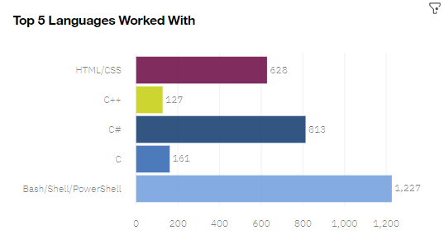
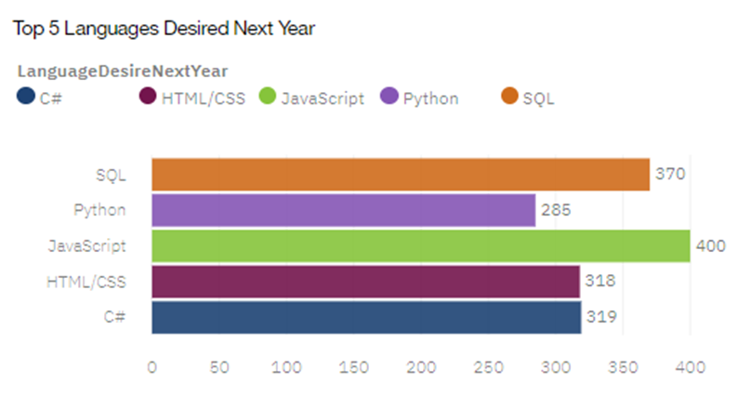
PROGRAMMING LANGUAGE TRENDS
Current Year
Next Year

Slide 7
PROGRAMMING LANGUAGE TRENDS - FINDINGS & IMPLICATIONS
Findings
Java and SQL become top desired languages
C# & HTML/CSS retain top 5 position but lose popularity
Python joins top 5 desired
Implications
Invest in training and systems for Java and SQL
Further investigate why C# & HTML/CSS lose popularity
Invest more in Python training and systems

Slide 8
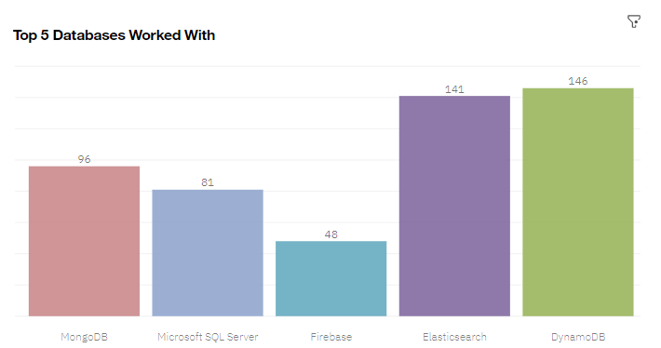
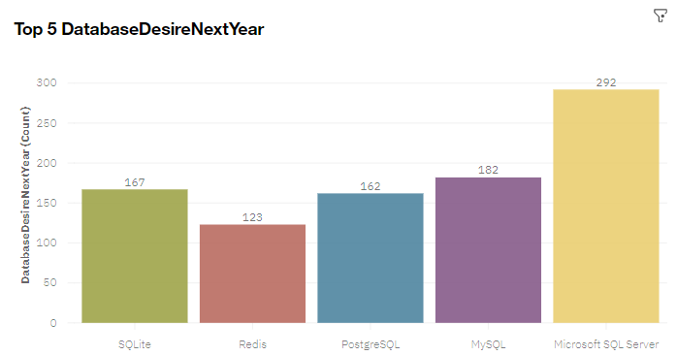
DATABASE TRENDS
Current Year
Next Year

Slide 9
DATABASE TRENDS - FINDINGS & IMPLICATIONS
Findings
Microsoft SQL becomes top desired by a margin
Current top 5 lose 4 databases as desired
SQL databases are in the top 3 desired
Implications
Review databases currently in use and upgrade
Invest more in SQL training and databases
Investigate reasons for Microsoft SQL becoming top desired database

Slide 10
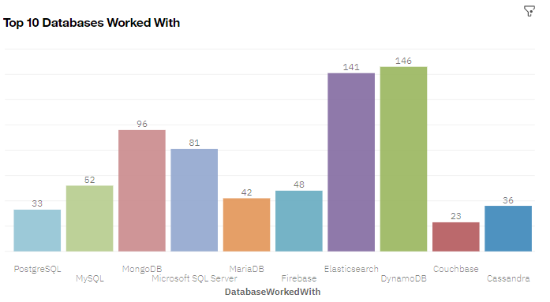
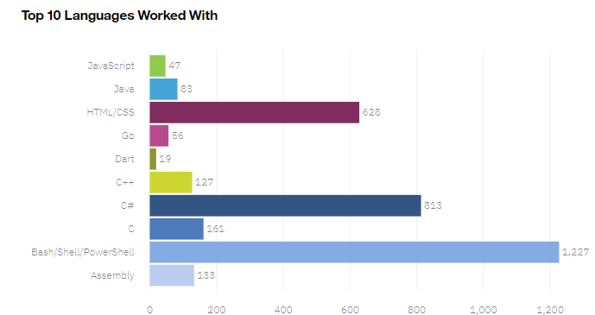
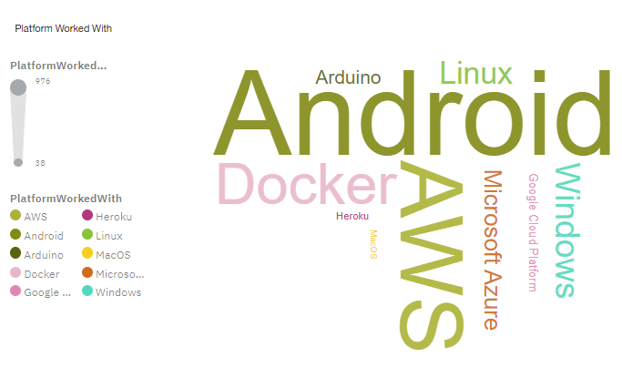
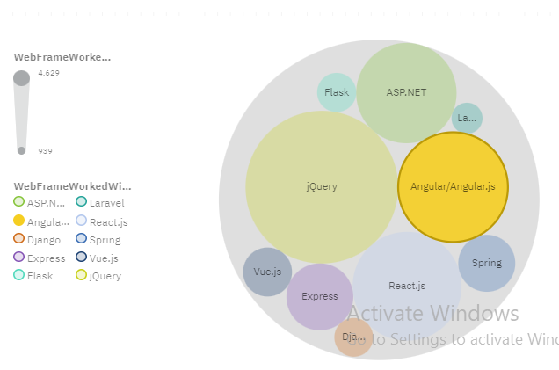
DASHBOARD TAB 1

Slide 11
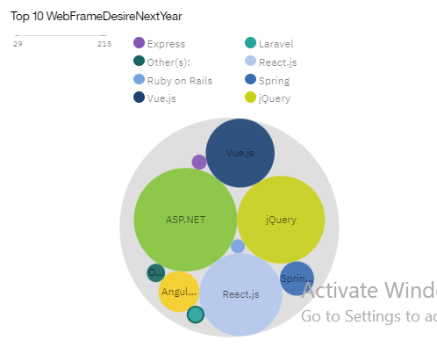
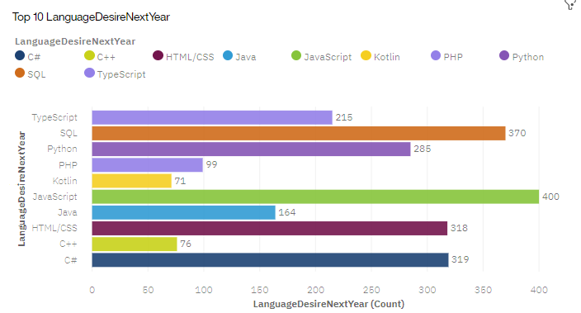
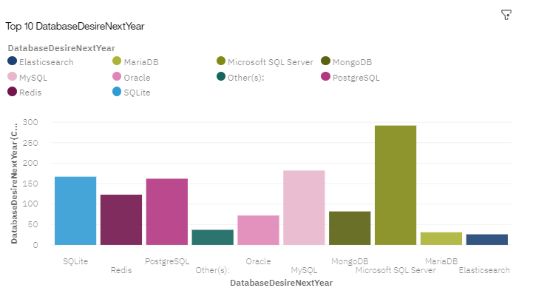
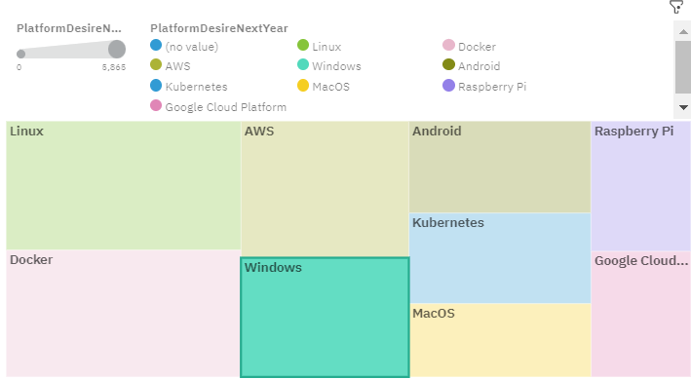
DASHBOARD TAB 2

Slide 12
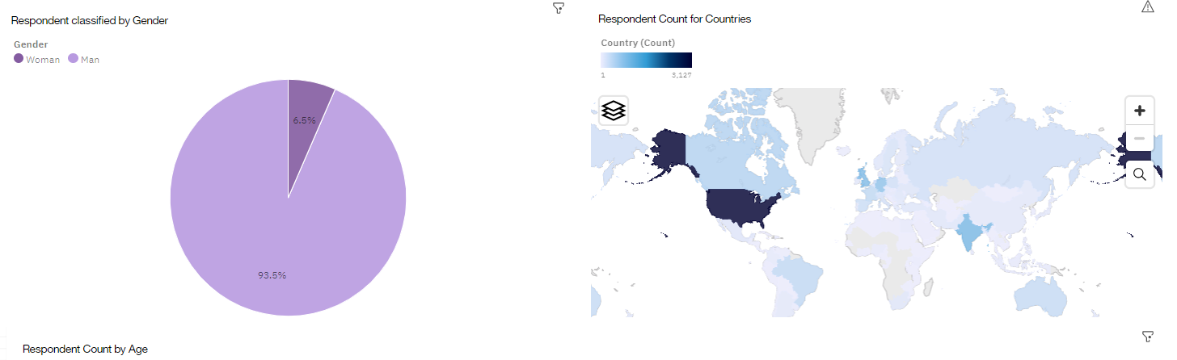
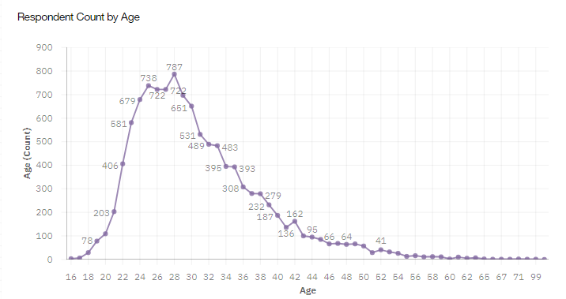
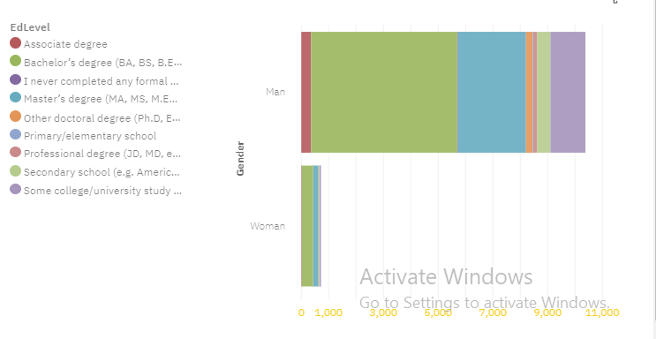
DASHBOARD TAB 3

Slide 13

DISCUSSION
Women are still the minority ( less than 10%) – are there any current practices preventing women from joining?
Most respondents have higher education (min Bachelor’s degree) – should this be changed in the industry to allow trained professionals without a formal degree to fill the skills gap?

Slide 14
OVERALL FINDINGS & IMPLICATIONS
Findings
Women are still the minority ( less than 10%) Finding 2
Most respondents are in their late twenties/early thirties
Vast majority of respondents have a bachelors or a masters degree
Implications
More women should be encouraged to join the industry
More of age diversity should be looked into
Attract more women and age groups by removing the degree requirements for jobs and allowing professional qualifications

Slide 15

CONCLUSION
Provide incentives and support for more women to join the industry
Invest in SQL languages & databases
Look to recruit candidates across different ages and educational backgrounds

Slide 16
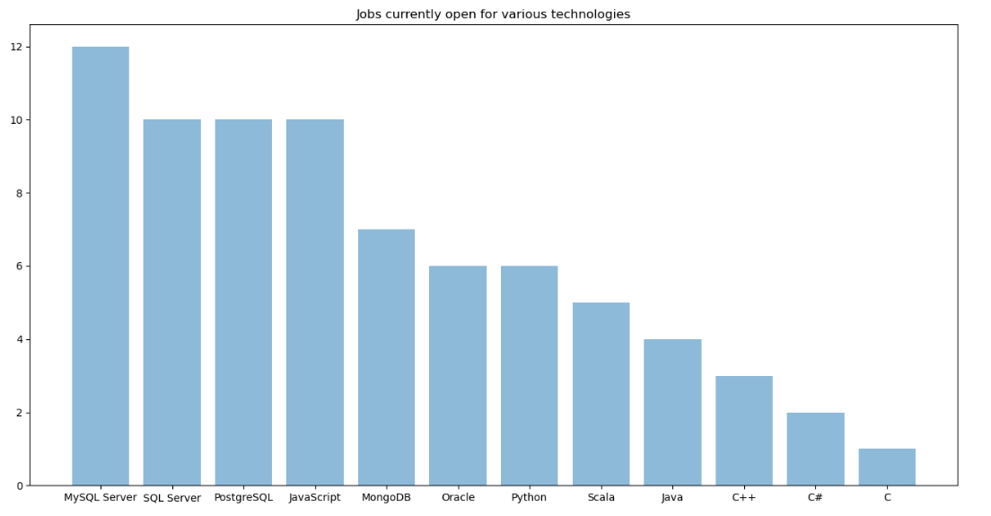
JOB POSTINGS

